Slide 1
Weekly Progress
Week 14

Slide 2
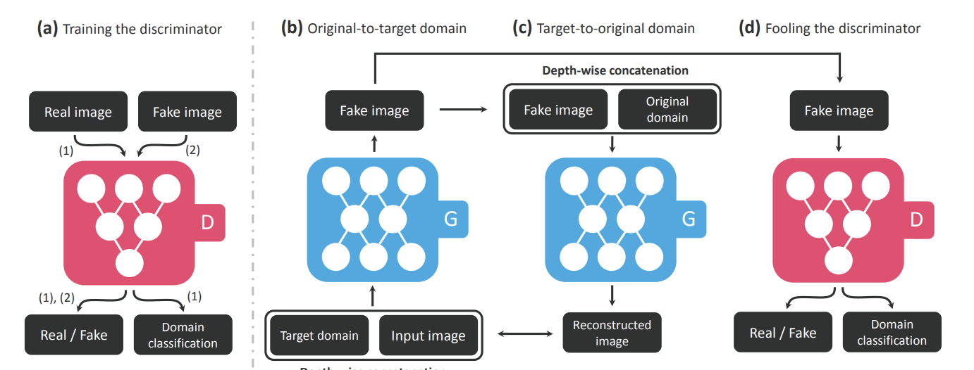
Emotion generator StarGAN
Trainset : RAF dataset with labels such as ‘happy’ and ‘angry’
(a) A discriminator learns to distinguish between real and fake images and classify the real images to its corresponding domain.
(b) Generator takes in as input both the image and target domain label and generates an fake image. The target domain label is spatially replicated and concatenated with the input image.
(c) Generator tries to reconstruct the original image from the fake image given the original domain label.
(d) Generator tries to generate images indistinguishable from real images and classifiable as target domain by a discriminator

Slide 3
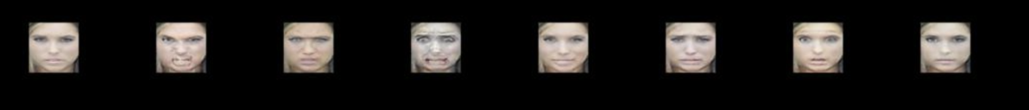
Emotion generator Result
Input Angry Contemptuous Disgusted Happy Sad Fearful Surprised

Slide 4
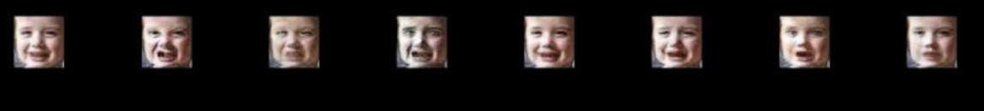
Emotion generator Result
Input Angry Contemptuous Disgusted Happy Sad Fearful Surprised

Slide 5
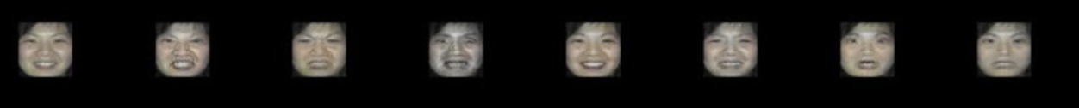
Emotion generator Result
Input Angry Contemptuous Disgusted Happy Sad Fearful Surprised

Slide 6
Feature plan for emotion generator
Choose labels for negative/positive facial expressions
Improve image quality
Test with SPT-Wav2Lip
Currently, generator can generate facial expressions with various input expressions

Slide 7
Lip Sync Methods
EAMM : had problem with colour channel and face was distorted
PC-AVS: thought the cause of face distortion was head pose source (input), but even without head pose, the face was distorted ( was trying to make an improvement on this without the head source but X, no training code)
Wav2Lip + CodeFormer: As Wav2Lip has problems of loosing teeth, blurry mouth area, CodeFormer was applied. It kind of restored the mouth area but it smoothed the region resulting in less accurate lip sync (+ but planning to apply CodeFormer on different lip sync results)
Video-Retalking: As above methods’ results were not as good as expected, Video-Retalking gave the best results and I’m planning to improve on this

Slide 8


Video-Retalking (with the given input source)
Input video
Output video (with different audio source)

Slide 9
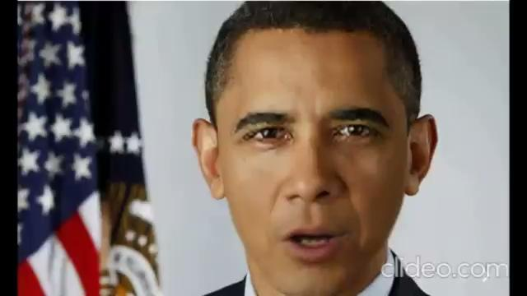
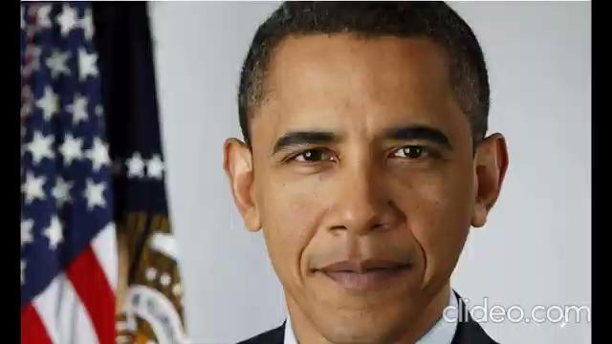
Video-Retalking
Input video (converted from a single image)
Generated output lip sync video

Slide 10
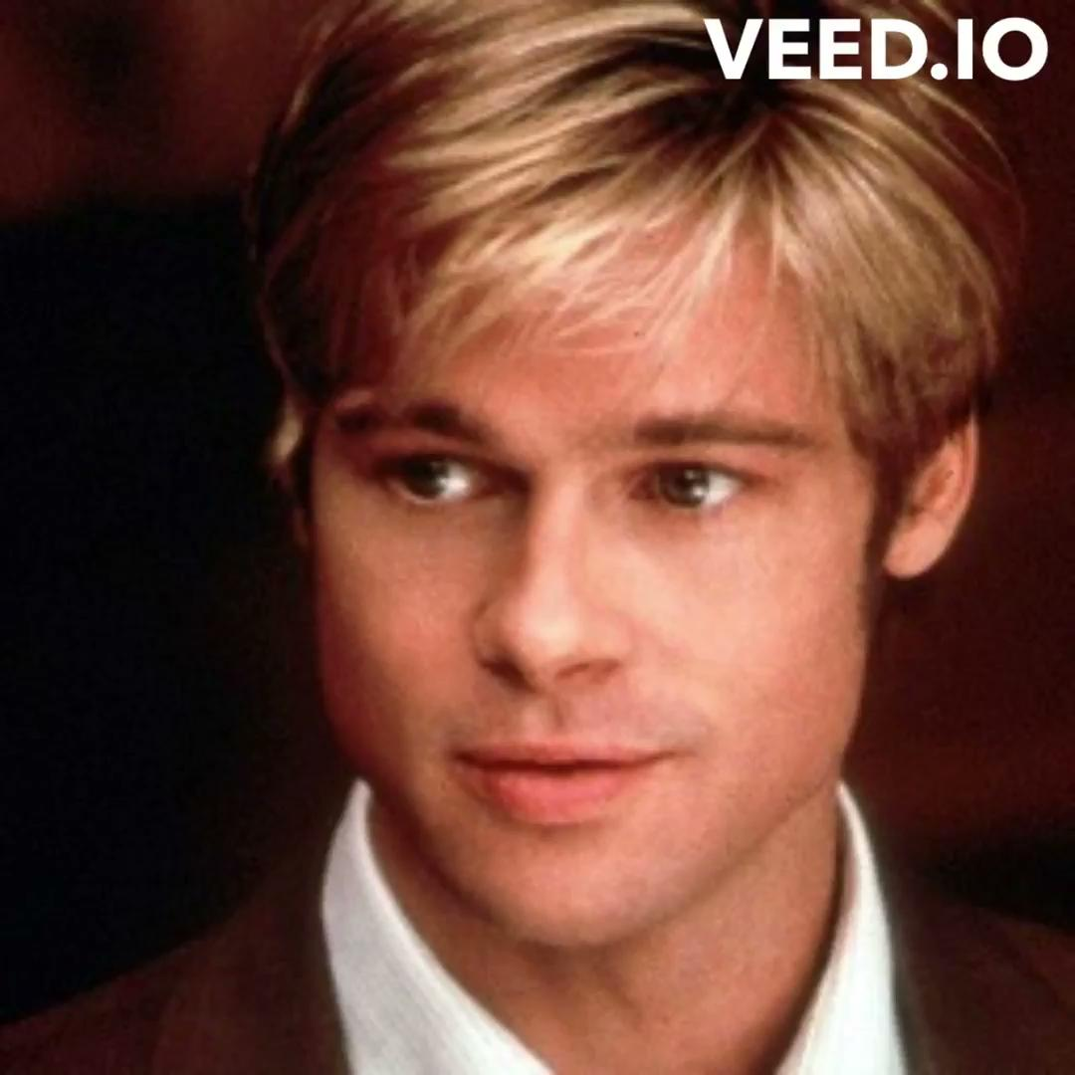

Video-Retalking
Generated output lip sync video
Input video (converted from a single image)

Slide 11
Improvement
Pre-processing (face alignment ? )
Add Head Pose
Post-processing (for higher quality)

